Slide 1
Feature Extraction (PCA+LDA)

Slide 2
Mathematical Tools (Recall)

Slide 3
Linear Independence
Different direction vectors are independent.
Parallel vectors are dependent. (+ve/-ve directions are parallel)

Slide 4
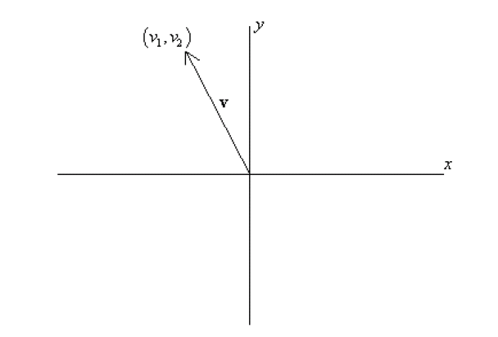
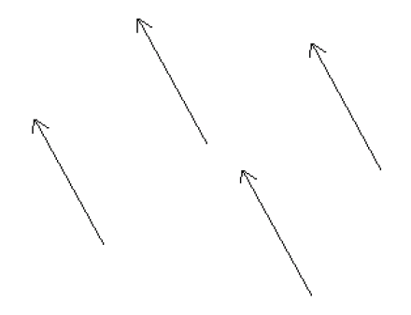
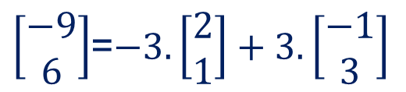
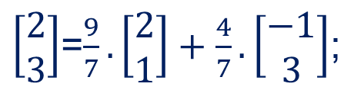
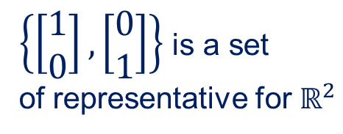
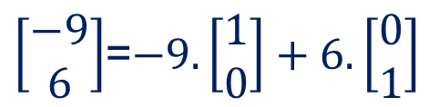
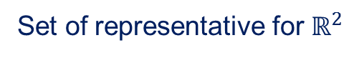
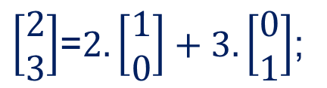
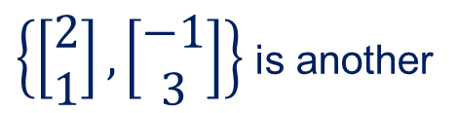
Basis & Orthonormal Bases
Basis (or axes): frame of reference
vs
Basis
$\left[\begin{matrix}2 \\ 3\end{matrix}\right]$=$2.\left[\begin{matrix}1 \\ 0\end{matrix}\right]+3.\left[\begin{matrix}0 \\ 1\end{matrix}\right]$;
$\left[\begin{matrix}−9 \\ 6\end{matrix}\right]$=$−9.\left[\begin{matrix}1 \\ 0\end{matrix}\right]+6.\left[\begin{matrix}0 \\ 1\end{matrix}\right]$
$\left\{\left[\begin{matrix}1 \\ 0\end{matrix}\right],\left[\begin{matrix}0 \\ 1\end{matrix}\right]\right\}$ is a set
of representative for $ℝ^{2}$
$\left[\begin{matrix}2 \\ 3\end{matrix}\right]$=$\frac{9}{7}.\left[\begin{matrix}2 \\ 1\end{matrix}\right]+\frac{4}{7}.\left[\begin{matrix}−1 \\ 3\end{matrix}\right]$;
$\left[\begin{matrix}−9 \\ 6\end{matrix}\right]$=$−3.\left[\begin{matrix}2 \\ 1\end{matrix}\right]+3.\left[\begin{matrix}−1 \\ 3\end{matrix}\right]$
$\left\{\left[\begin{matrix}2 \\ 1\end{matrix}\right],\left[\begin{matrix}−1 \\ 3\end{matrix}\right]\right\}$ is another
Set of representative for $ℝ^{2}$

Slide 5
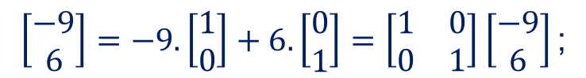
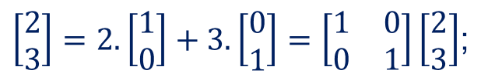
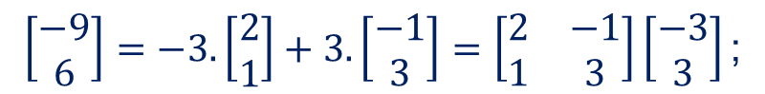
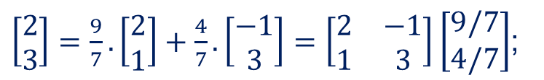
Basis & Orthonormal Bases
$\left[\begin{matrix}2 \\ 3\end{matrix}\right]=2.\left[\begin{matrix}1 \\ 0\end{matrix}\right]+3.\left[\begin{matrix}0 \\ 1\end{matrix}\right]=\left[\begin{matrix}1 & 0 \\ 0 & 1\end{matrix}\right]\left[\begin{matrix}2 \\ 3\end{matrix}\right]$;
$$\left[\begin{matrix}−9 \\ 6\end{matrix}\right]=−9.\left[\begin{matrix}1 \\ 0\end{matrix}\right]+6.\left[\begin{matrix}0 \\ 1\end{matrix}\right]=\left[\begin{matrix}1 & 0 \\ 0 & 1\end{matrix}\right]\left[\begin{matrix}−9 \\ 6\end{matrix}\right]\text{;}$$
Linear Transformation
$\left[\begin{matrix}2 \\ 3\end{matrix}\right]=\frac{9}{7}.\left[\begin{matrix}2 \\ 1\end{matrix}\right]+\frac{4}{7}.\left[\begin{matrix}−1 \\ 3\end{matrix}\right]$ $=\left[\begin{matrix}2 & −1 \\ 1 & 3\end{matrix}\right]\left[\begin{matrix}9/7 \\ 4/7\end{matrix}\right]$;
$$\left[\begin{matrix}−9 \\ 6\end{matrix}\right]=−3.\left[\begin{matrix}2 \\ 1\end{matrix}\right]+3.\left[\begin{matrix}−1 \\ 3\end{matrix}\right]=\left[\begin{matrix}2 & −1 \\ 1 & 3\end{matrix}\right]\left[\begin{matrix}−3 \\ 3\end{matrix}\right]\text{;}$$

Slide 6
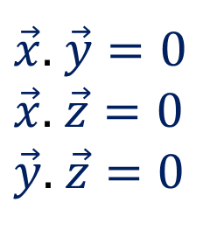
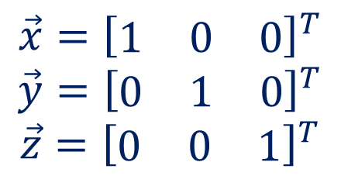
Basis & Orthonormal Bases
Basis: a space is totally defined by a set of vectors – any vector is a linear combination of the basis
Ortho-Normal: orthogonal + normal
[Sneak peek: Orthogonal: dot product is zero
Normal: magnitude is one ]
$$\vec{x}={\left[\begin{matrix}1 & 0 & 0\end{matrix}\right]}^{T}$$
$$\vec{y}={\left[\begin{matrix}0 & 1 & 0\end{matrix}\right]}^{T}$$
$$\vec{z}={\left[\begin{matrix}0 & 0 & 1\end{matrix}\right]}^{T}$$
$\vec{x}$. $\vec{y}=0$
$\vec{x}$. $\vec{z}=0$
$\vec{y}$. $\vec{z}=0$

Slide 7
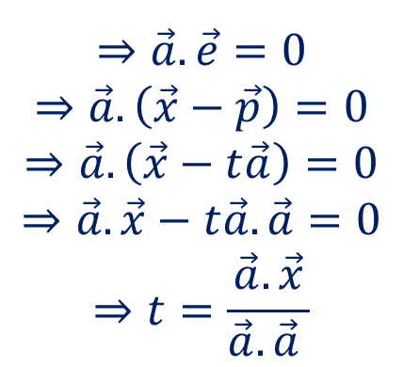
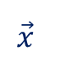
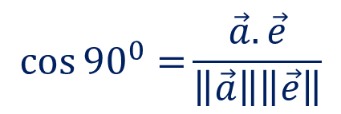
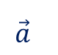
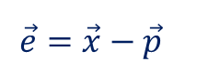
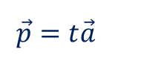

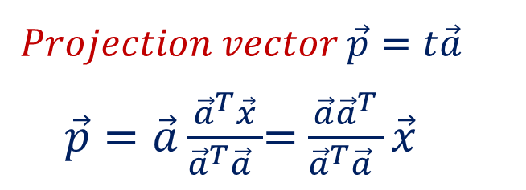
Projection: Using Inner Products
Projection of $\vec{x}$ along the direction $\vec{a}$
$$\cos{{90}^{0}=}\frac{\vec{a}.\vec{e}}{\left\|\vec{a}\right\|\left\|\vec{e}\right\|}$$
y
Light Source
$$⇒\vec{a}.\vec{e}=0$$
$$⇒\vec{a}.\left(\vec{x}−\vec{p}\right)=0$$
$$⇒\vec{a}.\left(\vec{x}−t\vec{a}\right)=0$$
$$⇒\vec{a}.\vec{x}−t\vec{a}.\vec{a}=0$$
$$⇒t=\frac{\vec{a}.\vec{x}}{\vec{a}.\vec{a} }$$
$$\vec{x}$$
$$\vec{e}=\vec{x}−\vec{p}$$
$$Projection vector \vec{p}=t\vec{a}$$
$\vec{p}=\vec{a}\frac{{\vec{a}}^{T}\vec{x}}{{\vec{a}}^{T}\vec{a} }$= $\frac{\vec{a}{\vec{a}}^{T}}{{\vec{a}}^{T}\vec{a} }\vec{x}$
$$\vec{a}$$
x
$$\vec{p}=t\vec{a}$$
Projection Matrix

Slide 8
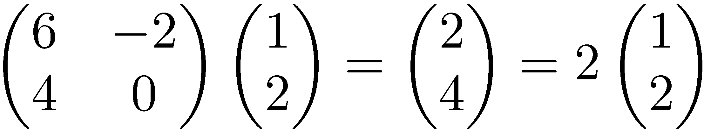

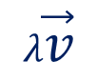

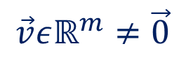


Eigenvalues & Eigenvectors
Eigenvectors (for a square m×m matrix S)
$$S\vec{v}=λ\vec{v}$$
Example
(right) eigenvector
eigenvalue
$$\vec{v}εℝ^{m}≠\vec{0}$$
$$λεℝ$$
$$S\vec{v}$$
$$\vec{v}$$
$$λ\vec{v}$$

Slide 9
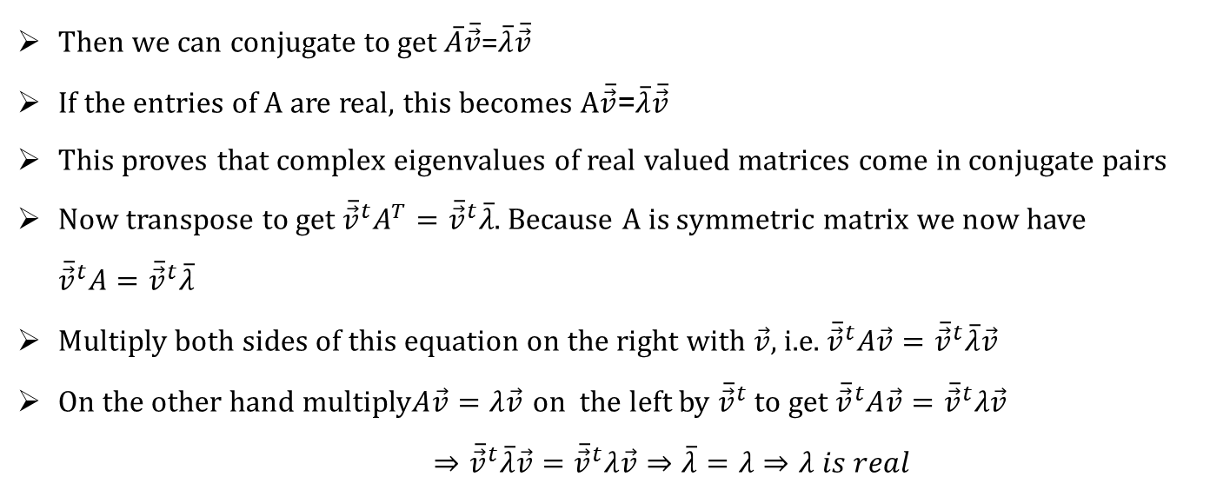
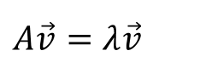
Eigenvalues & Eigenvectors (Properties)
The eigenvalues of real symmetric matrices are real.
$$A\vec{v}=λ\vec{v}$$
Then we can conjugate to get $\overline{A}\overline{\vec{v}}$=$\overline{λ}\overline{\vec{v}}$
If the entries of A are real, this becomes $A\overline{\vec{v}}\text{=}\overline{λ}\overline{\vec{v}}$
This proves that complex eigenvalues of real valued matrices come in conjugate pairs
Now transpose to get ${\overline{\vec{v}}}^{t}A^{T}={\overline{\vec{v}}}^{t}\overline{λ}$. Because A is symmetric matrix we now have ${\overline{\vec{v}}}^{t}A={\overline{\vec{v}}}^{t}\overline{λ}$
Multiply both sides of this equation on the right with $\vec{v}$, i.e. ${\overline{\vec{v}}}^{t}A\vec{v}={\overline{\vec{v}}}^{t}\overline{λ}\vec{v}$
On the other hand multiply$A\vec{v}=λ\vec{v}$ on the left by ${\overline{\vec{v}}}^{t}$ to get ${\overline{\vec{v}}}^{t}A\vec{v}={\overline{\vec{v}}}^{t}λ\vec{v}$
$⇒{\overline{\vec{v}}}^{t}\overline{λ}\vec{v}={\overline{\vec{v}}}^{t}λ\vec{v}⇒\overline{λ}=λ⇒λ is real$

Slide 10
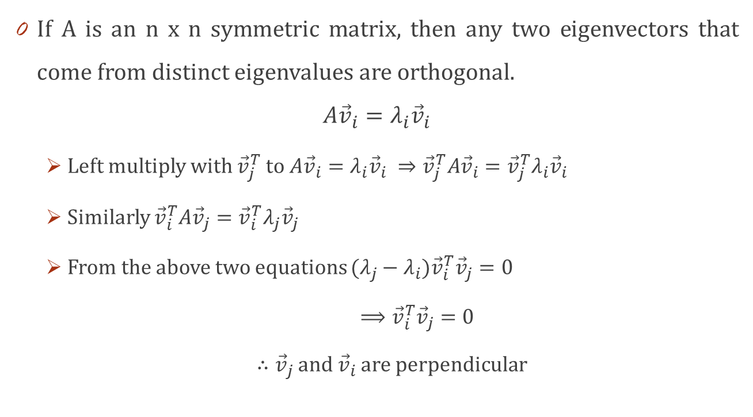
Eigenvalues & Eigenvectors (Properties)
If A is an n x n symmetric matrix, then any two eigenvectors that come from distinct eigenvalues are orthogonal.
$$A{\vec{v}}_{i}=λ_{i}{\vec{v}}_{i}$$
Left multiply with ${\vec{v}}_{j}^{T}$ to $A{\vec{v}}_{i}=λ_{i}{\vec{v}}_{i} ⇒{\vec{v}}_{j}^{T}A{\vec{v}}_{i}={\vec{v}}_{j}^{T}λ_{i}{\vec{v}}_{i}$
Similarly ${\vec{v}}_{i}^{T}A{\vec{v}}_{j}={\vec{v}}_{i}^{T}λ_{j}{\vec{v}}_{j}$
From the above two equations ${(λ_{j}−λ_{i})\vec{v}}_{i}^{T}{\vec{v}}_{j}=0$
$⟹{\vec{v}}_{i}^{T}{\vec{v}}_{j}=0$
$∴{\vec{v}}_{j}$ and ${\vec{v}}_{i}$ are perpendicular

Slide 11
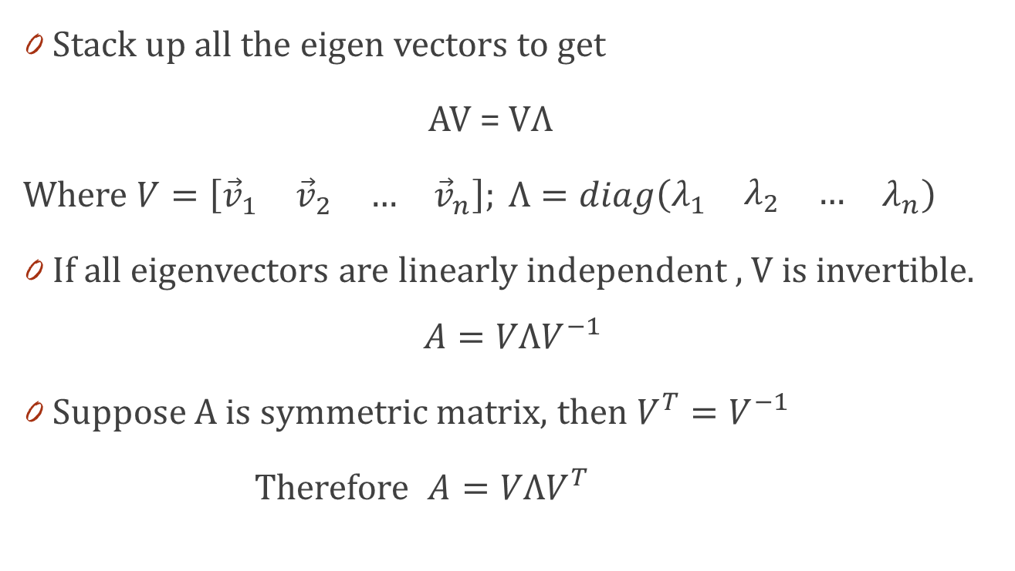
Diagonalization
Stack up all the eigen vectors to get
AV = VΛ
Where $V=\left[\begin{matrix}{\vec{v}}_{1} & \begin{matrix}{\vec{v}}_{2} & …\end{matrix} & {\vec{v}}_{n}\end{matrix}\right]; Λ=diag\left(\begin{matrix}λ_{1} & \begin{matrix}λ_{2} & …\end{matrix} & λ_{n}\end{matrix}\right)$
If all eigenvectors are linearly independent , V is invertible.
$$A=VΛV^{−1}$$
Suppose A is symmetric matrix, then $V^{T}=V^{−1}$
Therefore $A=VΛV^{T}$

Slide 12
Variance
Variance is the average squared deviation from the mean of a set of data. It is used to find the standard deviation.

Slide 13
Variance
Mean

Slide 14
Variance
2
-

Slide 15
Variance
2
-
2
-

Slide 16
Variance
1
2
2
----------------
………
+
-
+
-
+
………
No. of Data
Points

Slide 17
Variance
Find the mean
Find the deviation of each value from the mean
Square the deviations
Sum the squared deviations
Divide the sum by n
(gives typical squared deviation from mean)

Slide 18
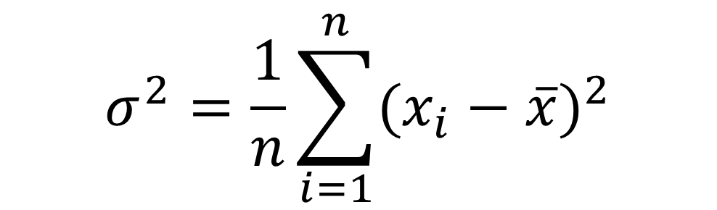
Variance Formula
$$σ^{2}=\frac{1}{n}\sum_{i=1}^{n}{{(x_{i}−\overline{x})}^{2}}$$

Slide 19
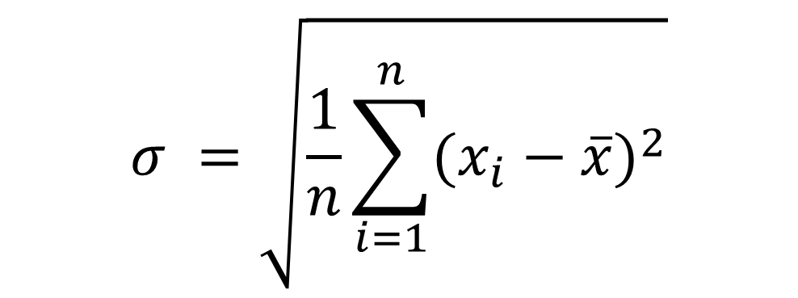
Standard Deviation
$$σ =\sqrt{\frac{1}{n}\sum_{i=1}^{n}{{(x_{i}−\overline{x})}^{2}}}$$
[ standard deviation = square root of the variance ]

Slide 20
Variance (2D)

Slide 21
Variance (2D)

Slide 22
Variance (2D)

Slide 23
Variance (2D)

Slide 24
Variance (2D)
Variance doesn’t explore
relationship between variables

Slide 25
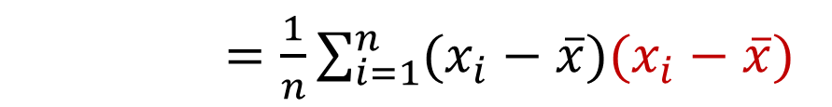
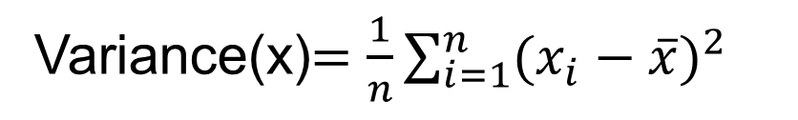
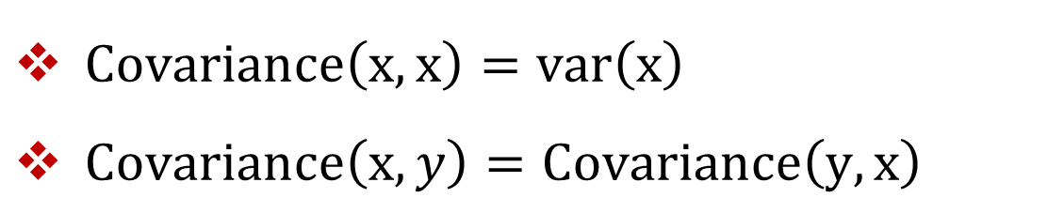
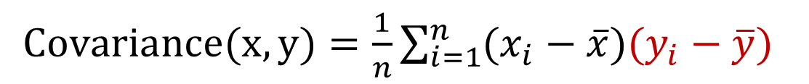
Covariance
Variance(x)$=\frac{1}{n}\sum_{i=1}^{n}{{(x_{i}−\overline{x})}^{2}}$
$=\frac{1}{n}\sum_{i=1}^{n}{(x_{i}−\overline{x})(x_{i}−\overline{x})}$
$Covariance(x,y)=\frac{1}{n}\sum_{i=1}^{n}{(x_{i}−\overline{x})(y_{i}−\overline{y})}$
$Covariance\left(x,x\right)=var\left(x\right)$
$Covariance\left(x,y\right)=Covariance\left(y,x\right)$

Slide 26
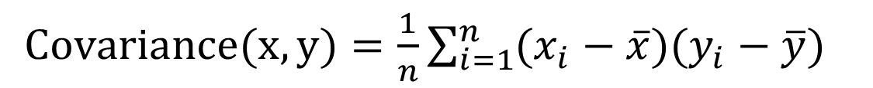
Covariance
$Covariance(x,y)=\frac{1}{n}\sum_{i=1}^{n}{(x_{i}−\overline{x})(y_{i}−\overline{y})}$

Slide 27
Covariance
$Covariance(x,y)=\frac{1}{n}\sum_{i=1}^{n}{(x_{i}−\overline{x})(y_{i}−\overline{y})}$

Slide 28
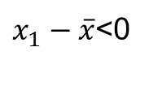
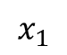
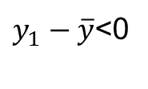
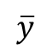
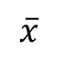
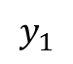
Covariance
$Covariance(x,y)=\frac{1}{n}\sum_{i=1}^{n}{(x_{i}−\overline{x})(y_{i}−\overline{y})}$
$$\overline{y}$$
$y_{1}−\overline{y}$<0
$$y_{1}$$
$$x_{1}$$
$$\overline{x}$$
$x_{1}−\overline{x}$<0

Slide 29
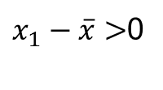
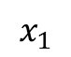
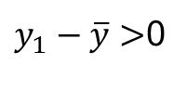
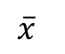
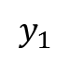
Covariance
$Covariance(x,y)=\frac{1}{n}\sum_{i=1}^{n}{(x_{i}−\overline{x})(y_{i}−\overline{y})}$
$$y_{1}$$
$y_{1}−\overline{y}>$0
$$\overline{y}$$
$$\overline{x}$$
$$x_{1}$$
$x_{1}−\overline{x}>$0

Slide 30
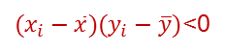
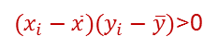
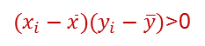
Covariance
$Covariance(x,y)=\frac{1}{n}\sum_{i=1}^{n}{(x_{i}−\overline{x})(y_{i}−\overline{y})}$
$(x_{i}−\overline{x})(y_{i}−\overline{y})$>0
$(x_{i}−\overline{x})(y_{i}−\overline{y})$<0
Positive
Relation
$(x_{i}−\overline{x})(y_{i}−\overline{y})$<0
$(x_{i}−\overline{x})(y_{i}−\overline{y})$>0

Slide 31
Covariance
$Covariance(x,y)=\frac{1}{n}\sum_{i=1}^{n}{(x_{i}−\overline{x})(y_{i}−\overline{y})}$

Slide 32
Covariance
$Covariance(x,y)=\frac{1}{n}\sum_{i=1}^{n}{(x_{i}−\overline{x})(y_{i}−\overline{y})}$

Slide 33






Covariance
$Covariance(x,y)=\frac{1}{n}\sum_{i=1}^{n}{(x_{i}−\overline{x})(y_{i}−\overline{y})}$
$$y_{1}$$
$y_{1}−\overline{y}>$0
$$\overline{y}$$
$$x_{1}$$
$$\overline{x}$$
$x_{1}−\overline{x}$<0

Slide 34




Covariance
$Covariance(x,y)=\frac{1}{n}\sum_{i=1}^{n}{(x_{i}−\overline{x})(y_{i}−\overline{y})}$
$$\overline{y}$$
$y_{1}−\overline{y}$<0
$$y_{1}$$
$$\overline{x}$$
$$x_{1}$$
$x_{1}−\overline{x}$>0

Slide 35



Covariance
$Covariance(x,y)=\frac{1}{n}\sum_{i=1}^{n}{(x_{i}−\overline{x})(y_{i}−\overline{y})}$
$\left(x_{i}−\overline{x}\right)\left(y_{i}−\overline{y}\right)<$0
$(x_{i}−\overline{x})(y_{i}−\overline{y})$>0
Negative
Relation
$(x_{i}−\overline{x})(y_{i}−\overline{y})$>0
$(x_{i}−\overline{x})(y_{i}−\overline{y})$<0

Slide 36
Covariance
$Covariance(x,y)=\frac{1}{n}\sum_{i=1}^{n}{(x_{i}−\overline{x})(y_{i}−\overline{y})}$

Slide 37



Covariance
$Covariance(x,y)=\frac{1}{n}\sum_{i=1}^{n}{(x_{i}−\overline{x})(y_{i}−\overline{y})}$
$\left(x_{i}−\overline{x}\right)\left(y_{i}−\overline{y}\right)<$0
$\left(x_{i}−\overline{x}\right)\left(y_{i}−\overline{y}\right)>$0
No
Relation
$\left(x_{i}−\overline{x}\right)\left(y_{i}−\overline{y}\right)<$0
$\left(x_{i}−\overline{x}\right)\left(y_{i}−\overline{y}\right)>$0

Slide 38


Covariance Matrix
$$Cov \left(∑\right)=\left[\begin{matrix}cov(x_{1},x_{1}) & cov(x_{1},x_{2}) & \begin{matrix}⋯ & cov(x_{1},x_{m})\end{matrix} \\ cov(x_{2},x_{1}) & cov(x_{2},x_{2}) & \begin{matrix}⋯ & cov(x_{2},x_{m})\end{matrix} \\ \begin{matrix}⋮ \\ cov(x_{m},x_{1})\end{matrix} & \begin{matrix}⋮ \\ cov(x_{m},x_{2})\end{matrix} & \begin{matrix}\begin{matrix}⋮ \\ ⋯\end{matrix} & \begin{matrix}⋮ \\ cov(x_{m},x_{m})\end{matrix}\end{matrix}\end{matrix}\right]$$
$$Cov \left(∑\right)=\frac{1}{n}\left(X−\overline{X}\right){\left(X−\overline{X}\right)}^{T};where X=\left[\begin{matrix}\begin{matrix}x_{1} \\ x_{2}\end{matrix} \\ ⋮ \\ x_{m}\end{matrix}\right]$$

Slide 39

Covariance Matrix
$$Cov \left(∑\right)=\left[\begin{matrix}cov(x_{1},x_{1}) & cov(x_{1},x_{2}) & \begin{matrix}⋯ & cov(x_{1},x_{m})\end{matrix} \\ cov(x_{2},x_{1}) & cov(x_{2},x_{2}) & \begin{matrix}⋯ & cov(x_{2},x_{m})\end{matrix} \\ \begin{matrix}⋮ \\ cov(x_{m},x_{1})\end{matrix} & \begin{matrix}⋮ \\ cov(x_{m},x_{2})\end{matrix} & \begin{matrix}\begin{matrix}⋮ \\ ⋯\end{matrix} & \begin{matrix}⋮ \\ cov(x_{m},x_{m})\end{matrix}\end{matrix}\end{matrix}\right]$$
Diagonal elements are variances, i.e. $Cov(x,x$)=$var\left(x\right)$.
Covariance Matrix is symmetric.
It is a positive semi-definite matrix.

Slide 40
Covariance Matrix
Covariance is a real symmetric positive semi-definite matrix.
All eigenvalues must be real
Eigenvectors corresponding to different eigenvalues are orthogonal
All eigenvalues are greater than or equal to zero
Covariance matrix can be diagonalized,
i.e. Cov = PDP^{T}

Slide 41
Correlation
Positive relation
Negative relation
No relation
Covariance determines whether relation is positive or negative, but it was impossible to measure the degree to which the variables are related.
Correlation is another way to determine how two variables are related.
In addition to whether variables are positively or negatively related, correlation also tells the degree to which the variables are related each other.

Slide 42



Correlation
$$ρ_{xy}=Correlation \left(x,y\right)=\frac{cov(x,y)}{\sqrt{var(x)}\sqrt{var(y)}. }$$
$$−1≤Correlation\left(x,y\right)≤+1$$

Slide 43
Feature Extraction

Slide 44
What is feature extraction?
Feature extraction refers to the mapping of the original high-dimensional data onto a lower-dimensional space.
Criterion for feature extraction can be different based on different problem settings.
Unsupervised setting: minimize the information loss
Supervised setting: maximize the class discrimination
Given a set of data points of m features
Compute the linear transformation (projection)

Slide 45
What is feature extraction?
Original data
reduced data
Linear transformation

Slide 46

High-dimensional data in computer vision
Face images
Handwritten digits

Slide 47
Principal Component Analysis

Slide 48

Example of a problem
We collected m features about 100 students:
Height
Weight
Hair color
Average grade
…..
We want to find the most important features that
best describe a student.

Slide 49
Example of a problem
Each student has a vector of data which describes him of length m:
(180,70,’purple’,84,…)
We have n = 100 such vectors. Let’s put them in one matrix, where each column is one student vector.
So we have a mxn matrix. This will be the input of our problem.

Slide 50
Example of a problem
Every student is a vector that lies in an m-dimensional vector space spanned by an orthonormal basis.
All data/measurement vectors in this space are linear combination of the set of standarad unit length basis vectors.
m-dimensional data vector
n- students

Slide 51
What features can we ignore?
Constant feature (number of heads)
1,1,…,1.
Constant feature with some noise - (thickness of hair)
0.003, 0.005,0.002,….,0.0008 low variance
Feature that is linearly dependent on other features (head size and height) : Z= aX + bY

Slide 52
Which features do we want to keep?
Feature that doesn’t depend on others (e.g. eye color), i.e. uncorrelated or low covariance.
Feature that changes a lot (grades)
The opposite of noise
High variance

Slide 53
Questions
How we describe ‘most important’ features using math?
– High Variance and Low Covariance
How do we represent our data so that the most important features can be extracted easily?
– Change of basis

Slide 54
Change of Basis
Let X and Y be mxn matrices related by a linear transformation P.
X is the original recorded data set and Y is a re-representation of that data set.
PX = Y
Let’s define;
p_{i} are the rows of P.
– x_{i} ’s are the columns of X.
– y_{i} ’s are the columns of Y.

Slide 55

Change of Basis
Let X and Y be mxn matrices related by a linear transformation P.
X is the original recorded data set and Y is a re-representation of that data set.
PX = Y
What does this mean?
P is a matrix that transforms X into Y.
Geometrically, P is a rotation and a stretch (scaling) which again transforms X into Y.
The rows of $P=\left\{p_{1},p_{2},…,p_{m}\right\}$ are a set of new basis vectors for expressing the columns of X.

Slide 56



Change of Basis
$$PX=\left[\begin{matrix}\begin{matrix}p_{1} \\ p_{2}\end{matrix} \\ ⋮ \\ p_{m}\end{matrix}\right]\left[x_{1},x_{2},…,x_{n}\right]$$
Lets write out the explicit dot products of PX.
We can note the form of each column of Y.
$$y_{i}=\left[\begin{matrix}\begin{matrix}p_{1}.x_{i} \\ p_{2}.x_{i}\end{matrix} \\ ⋮ \\ p_{m}.x_{i}\end{matrix}\right]$$
We can see that each coefficient of y_{i} is a dot product of x_{i} with the corresponding row in P.
$$Y=\left[\begin{matrix}p_{1}.x_{1} & p_{1}.x_{2} & \begin{matrix}… & p_{1}{.x}_{n}\end{matrix} \\ p_{2}.x_{1} & p_{2}.x_{2} & \begin{matrix}… & p_{2}.x_{n}\end{matrix} \\ \begin{matrix}⋮ \\ p_{m}.x_{1}\end{matrix} & \begin{matrix}⋮ \\ p_{m}.x_{2}\end{matrix} & \begin{matrix}\begin{matrix}\begin{matrix}⋱ & ⋮\end{matrix} & \end{matrix} \\ \begin{matrix}… & p_{m}.x_{n}\end{matrix}\end{matrix}\end{matrix}\right]$$
In other words, the j^{th} coefficient of y_{i} is a projection onto the j^{th} row of P.
Therefore, the rows of P are a new set of basis vectors for representing the columns of X.

Slide 57
Change of Basis
Changing the basis doesn’t change the data – only its representation.
Changing the basis is actually projecting the data vectors on the basis vectors.
Geometrically, P is a rotation and a stretch of X.
If P basis is orthonormal (length = 1) then the transformation P is only a rotation

Slide 58

Questions Remaining !!!
Assuming linearity, the problem now is to find the appropriate change of basis.
The rows vectors $\left\{p_{1},p_{2},…,p_{m}\right\}$ in this transformation will become the principal components of X.
Now,
What is the best way to re-express X?
What is the good choice of basis P?
Moreover,
what features we would like Y to exhibit?

Slide 59
What does “best express” the data means?
As we’ve said before, we want to filter out noise and extract the relevant information from the given data set.
Hence, the representation we are looking for will decrease both noise and redundancy in the data set at hand.

Slide 60

Noise
Noise in any data must be low or – no matter the analysis technique – no information about a system can be extracted.
There exists no absolute scale for the noise but rather it is measured relative to the measurement, e.g. recorded ball positions.
A common measure is the signal-to-noise ration (SNR), or a ratio of variances.
SNR$=\frac{σ_{signal}^{2}}{σ_{noise}^{2}}$
A high SNR (>>1) indicates high precision data, while a low SNR indicates noise contaminated data.

Slide 61

Why Variance ?!!!
Find the axis rotation that maximizes SNR = maximizes the variance between axis.

Slide 62

Redundancy …
Multiple sensors record the same dynamic information.
Consider a range of possible plots between two arbitrary measurement r₁ and r₂.
Panel(a) depicts two recordings with no redundancy, i.e. they are un-correlated, e.g. person’s height and his GPA.
However, in panel(c) both recordings appear to be strongly related, i.e. one can be expressed in terms of the other.

Slide 63
Redundancy …
Computing Covariance Matrix (S) quantifies the correlations between all possible pairs of measurements. Between one pair of measurements, a large covariance/correlation corresponds to a situation like panel (c), while zero covariance corresponds to entirely uncorrelated data as in panel (a)

Slide 64
Redundancy …
Suppose, we have the option of manipulating S_{X}. We will suggestively define our manipulated covariance matrix S_{Y}.
What features do you want to optimize in S_{Y}?

Slide 65
Diagonalize the Covariance Matrix
Our goals are to find the covariance matrix that:
Minimizes redundancy, measured by covariance. (off-diagonal).
i.e. we would like each variable to co-vary as little as possible with other variables.
Maximizes the signal, measured by variance. (the diagonal)

Slide 66

Diagonalize the Covariance Matrix PCA Assumptions
PCA assumes that all basis vectors $\left\{p_{1},p_{2},…,p_{m}\right\}$ are orthonormal (i.e. $p_{i}$. $p_{j}=δ_{ij}$).
Hence, in the language of linear algebra, PCA assumes P is an orthonormal matrix.
Secondly, PCA assumes the directions with the largest variances are the most “important” or in other words, most principal.
Why are these assumptions easiest?

Slide 67
Diagonalize the Covariance Matrix PCA Assumptions
By the variance assumption PCA first selects a normalized direction in m-dimensional space along which the variance in X is maximized - it saves this as p₁.
Again it finds another direction along which variance is maximized, however, because of the orthonormality condition, it restricts its search to all directions perpendicular to all previous selected directions.
This could continue until m directions are selected. The resulting ordered set of p’s are the principal components.
The variances associated with each direction p_{i} quantify how principal each direction is. We could thus rank-order each basis vector p_{i} according to the corresponding variances.

Slide 68

Solving PCA: Eigen Vectors of Covariance Matrix
We will derive an algebraic solution to PCA using linear algebra. This solution is based on an important property of eigenvector decomposition.
Once again, the data set is X, an m×n matrix, where n is the number of data patterns and m is the number of feature types.
The goal is summarized as follows:
Find some orthonormal matrix P where Y=PX such that is $S_{Y}=\frac{1}{n}YY^{T}$ diagonalized. (Assuming zero mean data i.e. subtract the mean)

Slide 69


Solving PCA: Eigen Vectors of Covariance Matrix
We begin by rewriting S_{Y} in terms of our variable of choice P.
$$S_{Y}=\frac{1}{n}YY^{T}$$
$$=\frac{1}{n}(PX){(PX)}^{T}$$
$=\frac{1}{n}PXX^{T}P^{T}$
$=\frac{1}{n}P\left(XX^{T}\right)P^{T}$
$=PAP^{T}$
Note that we defined a new matrix A=(1/n)XX^{T}, where A is symmetric .
Our roadmap is to recognize that a symmetric matrix (A) is diagonalized by an orthogonal matrix of its eigenvectors.
A symmetric matrix A can be written as EDE^{T}, where D is a diagonal matrix and E is a matrix of eigenvectors of A arranged as columns.
The matrix A has r $≤$ m orthonormal eigenvectors where r is the rank of the matrix.

Slide 70

Solving PCA: Eigen Vectors of Covariance Matrix
Now comes the trick. We select the matrix P to be a matrix where each row p_{i} is an eigenvector of (1/n)XX^{T}.
By this selection, P=E^{T}. Hence A=P^{T}DP.
With this relation and the fact that P⁻¹=P^{T} since the inverse of orthonormal matrix is its transpose, we can finish evaluating S_{Y} as follows;
$$S_{Y}=PAP^{T}$$
$$=P(P^{T}DP)P^{T}$$
$$=P(P^{T}DP)P^{T}$$
$$=(PP^{T})D(PP^{T})$$
$$=\left(PP^{−1}\right)D\left(PP^{−1}\right)$$
$S_{Y}=D$
It is evident that the choice of P diagonalizes S_{Y}. This was the goal for PCA.

Slide 71
What We Have Done So Far….

Slide 72
What We Have Done So Far….

Slide 73
What We Have Done So Far….
p₂
p₁

Slide 74
What We Have Done So Far….
p₂
p₁
No correlation in the new representation of the data

Slide 75


What We Have Done So Far….
p₂
$$λ_{2}$$
p₁
$$λ_{1}$$

Slide 76

PCA Process – STEP 1

Slide 77

PCA Process – STEP 1

Slide 78

PCA Process – STEP 2

Slide 79

PCA Process – STEP 3

Slide 80

PCA Process – STEP 3

Slide 81

PCA Process – STEP 4

Slide 82

PCA Process – STEP 4

Slide 83

PCA Process – STEP 4

Slide 84

PCA Process – STEP 4

Slide 85

PCA Process – STEP 5

Slide 86

PCA Process – STEP 5

Slide 87

PCA Process – STEP 5

Slide 88

PCA Process – STEP 5

Slide 89

Reconstruction of Original Data

Slide 90

Reconstruction of Original Data

Slide 91

Reconstruction of Original Data

Slide 92
What is Principal Component Analysis?
Principal component analysis (PCA)
Reduce the dimensionality of a data set by finding a new set of variables, smaller than the original set of variables.
Retains most of the input data information.
Useful for the compression and noise removal in the data.
By information we mean the variation present in the sample, given by the correlations between the original variables.
The new variables, called principal components (PCs), are uncorrelated, and are ordered by the fraction of the total information each retains.

Slide 93


Geometric picture of Principal Components (PCs)
the 1st PC is a maximum variance fit to a line in X space
the 2nd PC is a second maximum variance fit to a line in the plane perpendicular to the 1st PC

Slide 94
Geometric picture of principal components (PCs)

Slide 95
Geometric picture of principal components (PCs)

Slide 96
Geometric picture of principal components (PCs)

Slide 97
Algebraic definition of PCs
Given a sample of ‘n’ observations on a vector of ‘d’ variables
Define the first principal component of the sample by the linear transformation
Here a₁ is chosen such that v[z₁] is maximum.
where the vector

Slide 98
Algebraic definition of PCs
To find first note that
where
is the covariance matrix.

Slide 99
Algebraic definition of PCs
To find that maximizes subject to
Let λ be a Lagrange multiplier
therefore
is an eigenvector of S
corresponding to the largest eigenvalue

Slide 100
Algebraic definition of PCs
We find that is also an eigenvector of S
whose eigenvalue is the second largest.
In general
The k^{th} largest eigenvalue of S is the variance of the k^{th} PC.
The k^{th} PC retains the k^{th} greatest fraction of the variation
in the sample.

Slide 101
Algebraic derivation of PCs
Main steps for computing PCs
Form the covariance matrix S.
Compute its eigenvectors:
The first p eigenvectors corresponds to ‘p’ largest eigenvalues form the ‘p’ PCs.
The transformation G consists of the p PCs:

Slide 102


PCA for image compression
p=1
p=2
p=4
p=8
Original Image
p=16
p=32
p=64
p=100

Slide 103
Outline of lecture
What is feature reduction?
Why feature reduction?
Feature reduction algorithms
Principal Component Analysis (PCA)
Linear Discriminant Analysis (LDA)

Slide 104
Linear Discriminant Analysis

Slide 105
Is PCA a good criterion for classification?
Data variation determines the projection direction
What’s missing?
Class information

Slide 106
What is a good projection?
Two classes overlap
Similarly, what is a good criterion?
Separating different classes
Two classes are separated

Slide 107
What class information may be useful?
Between-class distance
Distance between the centroids of different classes
Between-class distance

Slide 108
What class information may be useful?
Between-class distance
Distance between the centroids of different classes
Within-class distance
Accumulated distance of an instance to the centroid of its class
Within-class distance

Slide 109
Linear Discriminant Analysis (LDA)
Linear discriminant analysis (LDA)
finds most discriminant projection by
maximizing between-class distance
and minimizing within-class distance

Slide 110
Linear Discriminant Analysis (LDA)
Linear discriminant analysis (LDA)
finds most discriminant projection by
maximizing between-class distance and
minimizing within-class distance

Slide 111
Linear Discriminant Analysis (LDA)
Between-class distance
Within-class distance

Slide 112
Notations
Training data from different classes 1, 2, …, k
Data matrix

Slide 113
Notations
C_{i} is the centroid of i^{th} Class
C is the centroid of all classes
Between-class scatter
Within-class scatter
Properties:
Between-class distance = trace of between-class scatter (I.e., the summation of diagonal elements of the scatter)
Within-class distance = trace of within-class scatter

Slide 114
Discriminant criterion
Discriminant criterion in mathematical formulation
Between-class scatter matrix
Within-class scatter matrix
The optimal transformation is given by solving a generalized eigenvalue problem
G_{dxd} is the projection matrix

Slide 115
Graphical view of projection
K-1
K-1
d
n
n
d
d
K-1
1
1
A test data point h

Slide 116
Issues in LDA
is required to be nonsingular.
Singularity or undersampled problem (when n<d)
Example: gene expression data (d is around few thousands and n is around few hundreds), images, text documents
Approaches
PCA+LDA (PCA: Principal Component Analysis)
Regularized LDA:
Uncorrelated LDA
Orthogonal LDA

Slide 117
Summary
Feature reduction is an important pre-processing step in many applications.
Unsupervised versus supervised
PCA and LDA
Research problems:
Semi-supervised feature reduction
Nonlinear feature reduction
Determination of the reduced dimension in PCA

